Slide 1

Google Data Analytics Case Study
Cyclistic Bike-Share
With
Jupiter-Notebook & POWERBI

Slide 2
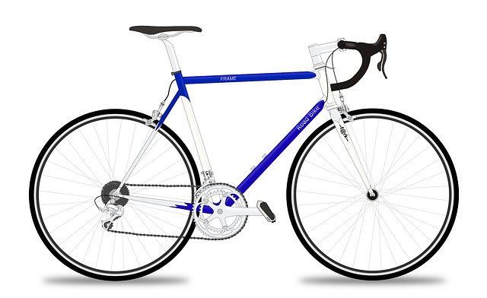
CONTENTS
00
Introduction
01
Ask
02
Prepare
03
Process
04
Analyze
05
Share
06
Act

Slide 3
00
INTRODUCTION

Slide 4
Company Summary
Cyclistic is a bike-share company located in Chicago. It has a bike share program that features more than 5,800 bicycles and 600 docking stations.
Its provides reclining bikes, hand tricycles, and cargo bikes, making bike-share more inclusive to people with disabilities and riders who can’t use a standard two-wheeled bike.

Slide 5
01
ASK

Slide 6
Ask Phase
Problem Statement
Ensure Key growth of Cyclistic by increasing the number of annual members
Business Task
The task here is to show how annual members and casual riders use cyclistic bikes differently.
Stakeholders
The main share holders are the director of Marketing(Lili moreno), Cyclistic Marketing and Cyclistic Analytic Team

Slide 7
02
PREPARE

Slide 8
Prepare Phase
Information on Data Source
The data is publicly available on Index of bucket "divvy-tripdata“
The data is stored in 12 csv files
The data range from 2021-09 to 2022-08
The data is representative
Is Data ROCCC
Reliable : it has multiple data and for long period
Original: It is third party data
Comprehensive : The data has clear components and informations
Current: The data is quite old(last 1 year data)
Cited : The data source is unknown.

Slide 9
03
PROCESS

Slide 10
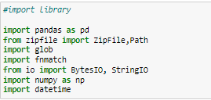


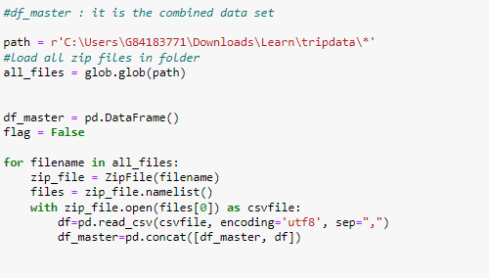
Process Phase
Importing library
Dataset Columns info
Combining all csv files into one

Slide 11
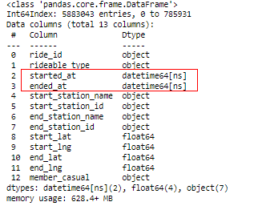

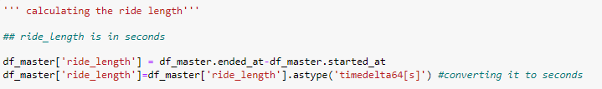
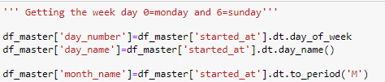
Process Phase
Changing Column data type
Calculating ride Length
Getting Week Day

Slide 12



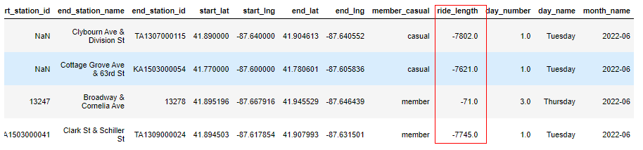
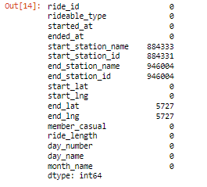

Process Phase
Removing inconsistencies
Check for duplicates
Check for missing values
After identifying inconsistencies, we create a new dataset with positive ride lengths

Slide 13
04
ANALYZE

Slide 14


Analyze Phase
Type of users
We can classify users from the <<member_casual>> column. These users are :
Casual : These are the target users we want to convert.
Member: These are annual users of the bike share program
Calculating Average ride length
Calculating max ride length

Slide 15

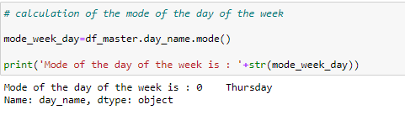

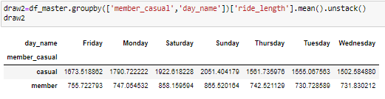
Analyze Phase
Calculating Mode of day of the week
Exporting Final dataset for visualization
Average ride length per user type
Average ride length per user type by day of week

Slide 16
05
SHARE

Slide 17
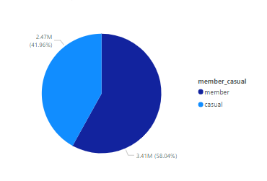
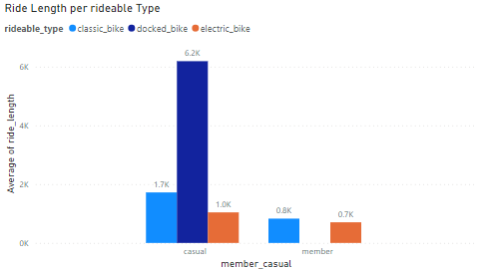
Share Phase
58.04%(3.41M) of the riders are annual members while 41.96%(2.47M) are casual riders.
Annual members form the majority of total riders. So increasing them will help to reach the objective
Casual users use all bikes types
Annual members prefer classic bikes and electric bikes
Casual users mainly rides using docked bike

Slide 18
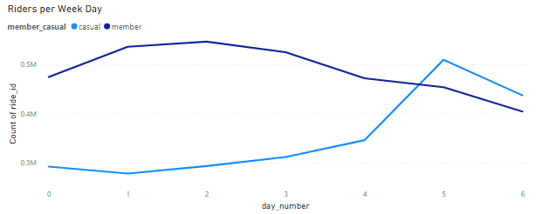
Share Phase
Annual members rides decrease during the weekend. Annual members mainly rides during the week.
Casual members rides are small during during the week but increase during the weekend.
This graph shows that the casual members mainly rides for leisure.

Slide 19
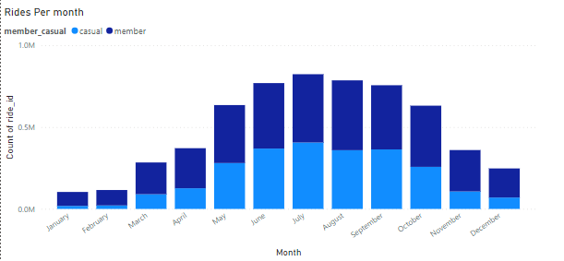
Share Phase
Both rider types number obey the same trends on monthly overview.
Number of Rides increase in the year between the month of April to October.
Number of rides decrease between November February. This correspond to Winter season.

Slide 20
06
ACT

Slide 21
Act Phase
Recommendations
Special marketing campaign must be done during the weekend as rides numbers are higher during the weekend.
Create a special campaign for docked bike as casual users prefers to ride on these bikes
Discount can be done during the week to help casual riders to increase their rides times.
Company should increase campaigns activities during summer seasons as riders are increasing.

Slide 22

THANK YOU!
Presentation by GNINGHAYE Malcolmx Hassler
https://www.linkedin.com/in/malcolmx-hassler-gninghaye-guemandeu-77a5b11b0/

